Slide 1

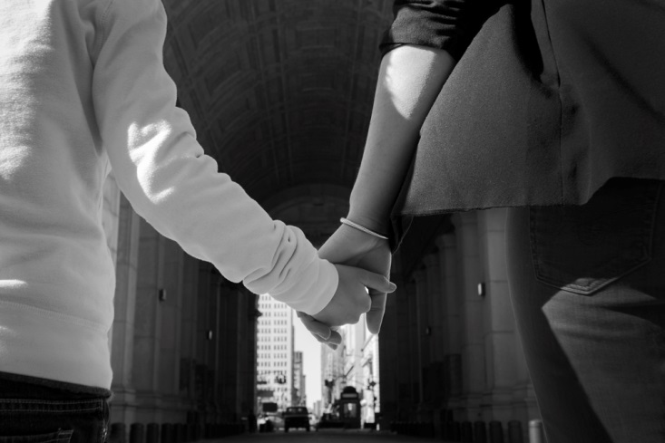
Unaccompanied Children in Immigration

Slide 2
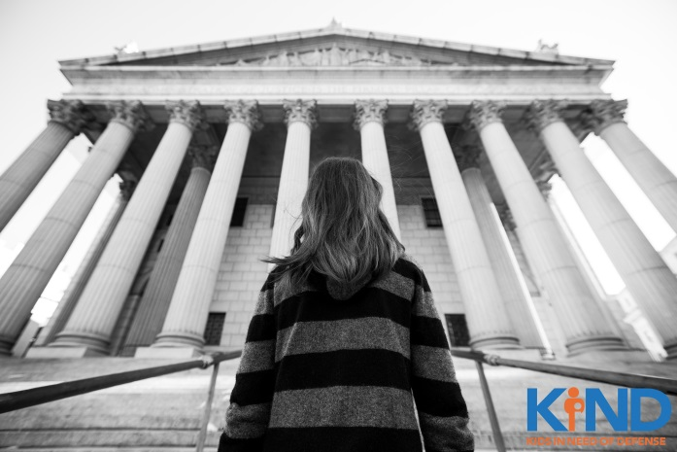
KIND was founded by Angelina Jolie and the Microsoft Corporation to create a pro bono movement to provide quality and compassionate legal counsel to unaccompanied refugee and immigrant children in the United States.
KIND serves as the leading organization for the protection of unaccompanied children who enter the U.S. immigration system alone and strives to ensure that no such child appears in immigration court without representation.

Slide 3



We provide lawyers to help them navigate the legal system
We advocate for policies that protect the rights of these children
If a child cannot stay in the US, we help them to return safely to their homes

Slide 4
TOPICS FOR TODAY
Unaccompanied Children 101
Immigration Court 101
Potential Humanitarian Legal Remedies
Child Client Practice Tips
Mentorship by KIND

Slide 5
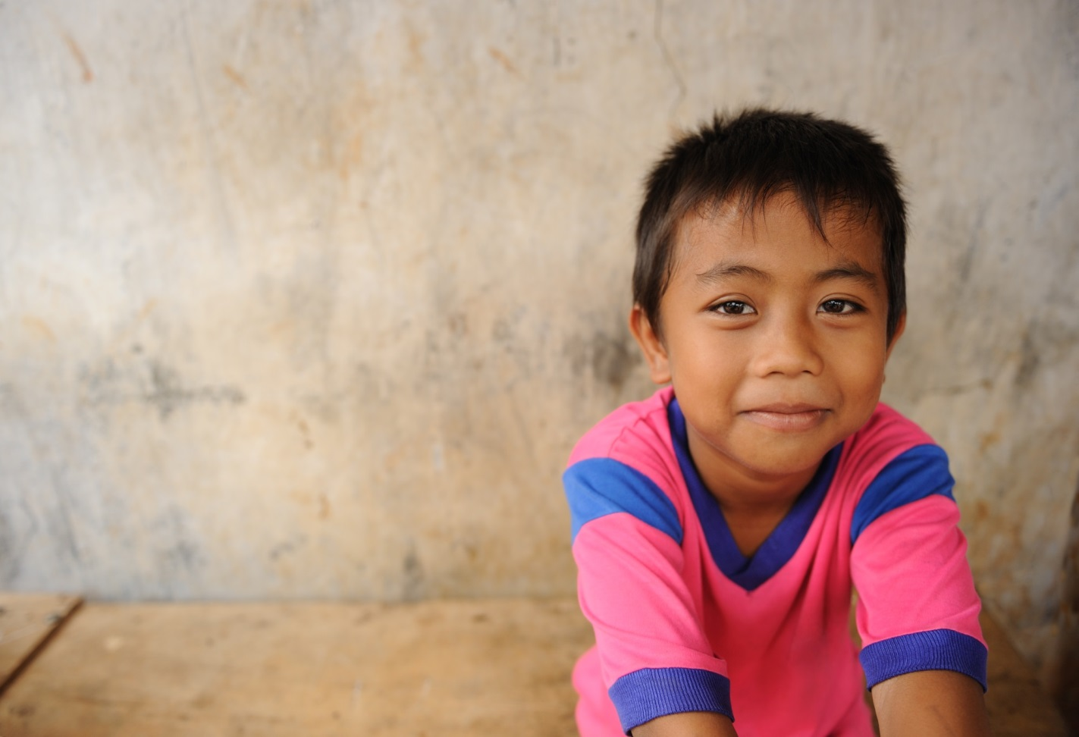
WHO IS AN UNACCOMPANIED CHILD?

Slide 6
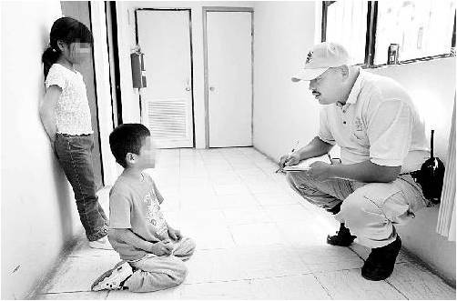
“UNACCOMPANIED ALIEN CHILD” DEFINED
  Homeland Security Act, 6 USC §279(g)
  no lawful immigration status
  under age18
  no parent or legal guardian in the U.S. available to provide care &
  physical custody
Photo: Latinalista

Slide 7
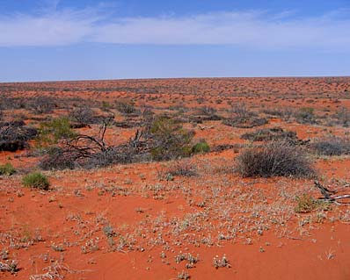
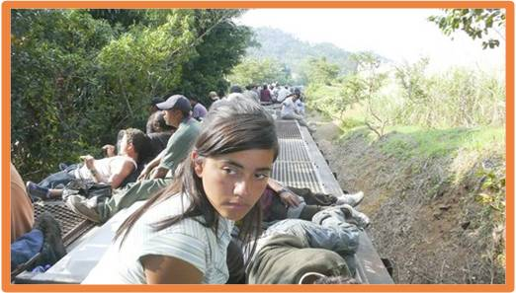
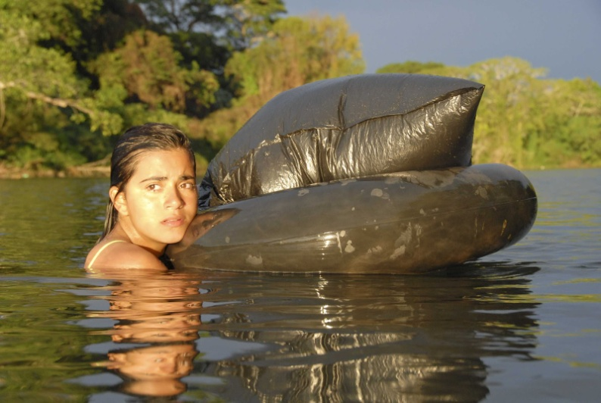
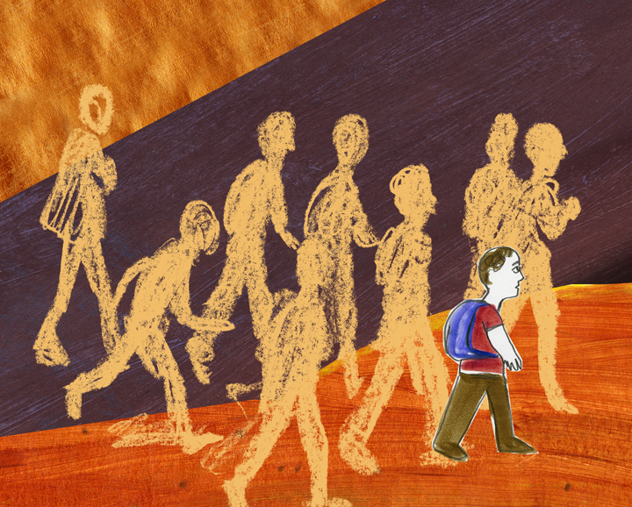
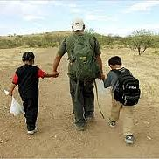
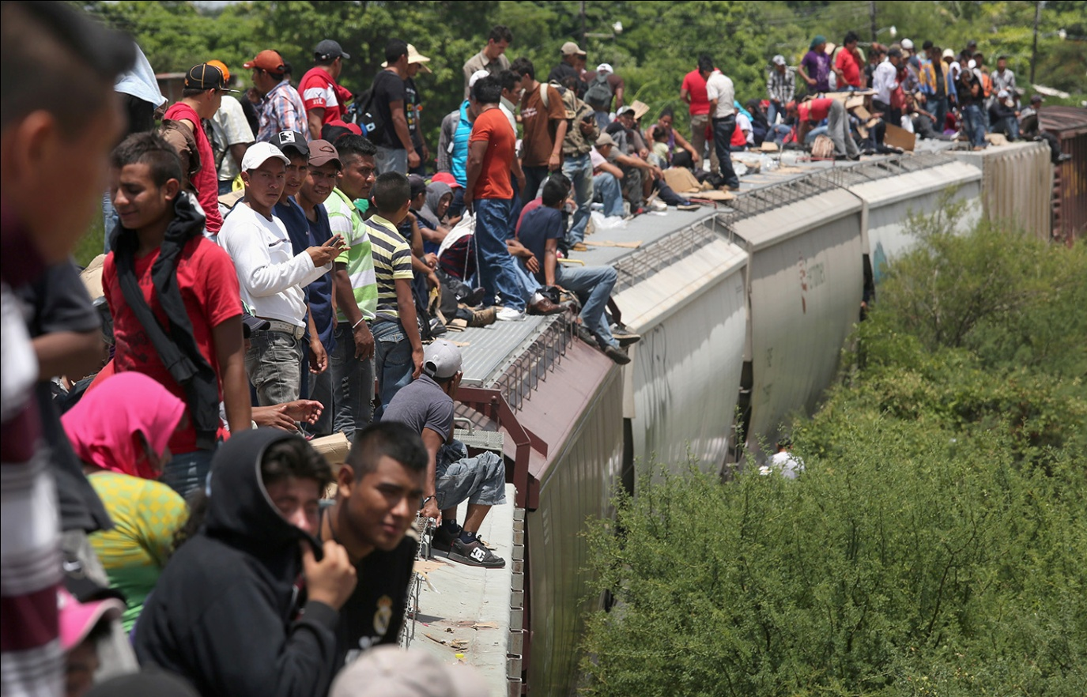
HASTA LA FRONTERA
Notes:
coyotes, the journey, desert/river crossing, zetas, sexual/physical abuse, dangers, train jumping, starvation, dehydration
How do they get here?
Some come on their own, some in groups, some are smuggled in by “coyotes”, some are victims of trafficking
Transportation??
On foot, by bus, train, boat, plain, or hitch-hicking
Dangers
Witness horrific crimes (smugglers bad guys), victims of physical and sexual abuse, train jumping, starvation, dehydration, packed into trailers and required to stand for days without food or water, no adult they trust on the journey to protect them, encounter cartels, cross the river and/or desert

Slide 8
CHILD MIGRATION
Why? | Who decided? | With whom? | How? | What happened?
Domestic violence (DV), Femicide | I was too young to know | Smugglers Guides Coyotes | Ticketed passenger | Incurred debt, Deported from Mexico
Persecution | It was up to my parents | Traffickers | Cargo/freight | Hunger, dehydration
Poverty, No caretaker | I decided, My family was/not opposed | Strangers Friends | Motor vehicle Raft On foot | Environmental Hazards of Route: Desert, River
Separation from family | I left without telling anyone | Family | Valid papers No papers Invalid papers | Social Hazards, Crime: Assault, sexual assault, kidnapping
Notes:
From DHS Form I-213: “Subject is 1 of 9 apprehended at Port Laredo Train Yards, approximately 12 miles north of Laredo, Texas on 8/23/2006. Subject illegally entered the United States by wading across the Rio Grande River . . . .
Subject left his native country Honduras on July 19, 2006. Subject stated that he had traveled by bus to the border with Guatemala [and] traveled through Guatemala by boat … Subject claims that he entered illegally into Mexico on July 21, 2006, wading across a river [and] continued traveling through Mexico by freight train until his arrival to Nuevo Laredo … on August 07, 2006. Subject claims that once in Nuevo Laredo he was kept in a house by some smugglers, who were asking for $400 in order to let him go. Subject stated that he was kept against his will in a house for about a week until his family wired $400.00 dollars to the smugglers. Subject further states that he was tied with ropes and threatened with a handgun.”

Slide 9
STATISTICS ON UAC MIGRATION
  Apprehensions of Unaccompanied Children in the US:
    FY 2008: 8,000
    FY 2012: 14,000
    FY 2013: 23,000
    FY 2014: 68,000 +
    FY 2015: 40,000
    FY 2016: 59,000
    FY 2017 (first quarter): 20,000
    Source: Department of Homeland Security

Slide 10
UAC RELEASED TO SPONSORS BY COUNTY
State | County | # Released*
CA | Los Angeles | 3,217
FL | Miami-Dade | 1,203
FL | Palm Beach | 1,148
MD | Prince George’s | 1,281
NY | Nassau | 1,072
NY | Suffolk | 1,322
TX | Harris | 3,144
TX | Dallas | 1,001
VA | Fairfax | 1,176

Slide 11
UAC JOURNEY THROUGH IMMIGRATION PROCEEDINGS
Child placed in DHS custody for less than 72 hours.
Child transferred to HHS Office of Refugee Resettlement Custody (placed in shelter)
Continue in
ORR
Custody
Immigration Relief Obtained
Child apprehended at the border, a port of entry, or after other law enforcement interaction.
Removed In Absentia
Released to ORR Sponsor
Removed /
Voluntary Departure
ICE Issues Notice to Appear (NTA)
Child or Conservator served with NTA
ICE Files NTA in Court
EOIR: IMMIGRATION REMOVAL PROCEEDINGS

Slide 12
KIND’S ROLE IN THE UAC PROCESS
KIND: | Pro bono counsel:
Interview child released to Harris or Montgomery County to assess potential for relief Map proposed route to relief for pro bono placement Create and provide toolkits for pro bono attorneys, including templates, samples, checklists, research ideas, other resources Provide one-on-one mentorship in each case, including strategy discussions, feedback on drafts, mock adjudications, troubleshooting, and more through duration of case | Meet with and interview client Counsel client on options Prepare applications for relief Represent child before immigration court, U.S. Citizenship and Immigration Services and possibly family court Counsel client on results

Slide 13
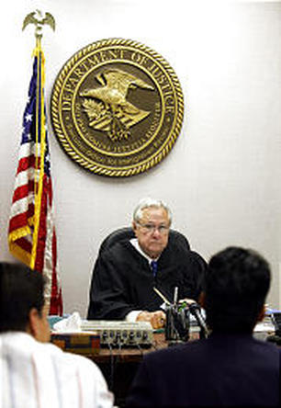
REMOVAL PROCEEDINGS

Slide 14
Dept. of Homeland Security: DHS
Citizenship & Immigration Services: USCIS/CIS
Immigration & Customs Enforcement: ICE
Customs & Border Protection: CBP
USCIS Asylum Office
ICE Trial Attorneys (TA’s)
Dept. of Justice: DOJ
Executive Office for Immigration Review: EOIR
Immigration Court: IC
Board of Immigration Appeals: BIA
Immigration Judges: IJs
DHS
DOJ
State Court
HHS
Dept. of Health & Human Services: HHS
Office of Refugee Resettlement : ORR – VRF (form)
Unaccompanied Refugee Minors: URM
Div. Of Unaccompanied Children’s Services: DUCS
State Court
Family Court SAPCRs
Juvenile Court Declaratory Judgments

Slide 15
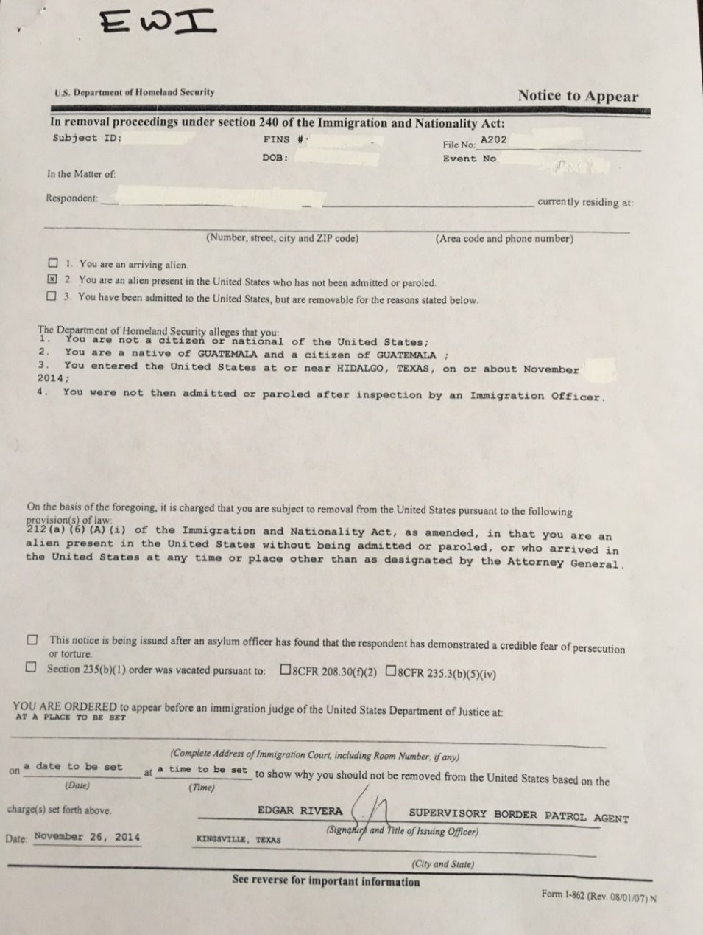
REMOVAL PROCEEDINGS
Civil proceedings – INA § 240
  Forum: Immigration Court – within DOJ
  Opposing Counsel: ICE Office of Chief Counsel Trial Attorney (“TA”) – within DHS
Children’s rights and best interests not a discretionary factor for immigration judge
Commenced by filing & serving Notice to Appear
High stakes situation
No right to appointed counsel

Slide 16
THE MASTER CALENDAR HEARING
Preliminary Hearing
  Enter appearance as attorney
  Take pleadings
  State forms of relief
  Request continuance to prepare case or to pursue immigration relief outside of court
  File or renew applications for relief (e.g., asylum)
  Update the court on case status
  Update the court on Respondent’s address
  Schedule an individual hearing: asylum cases
Notes:
All potential forms of relief that you may be seeking MUST be identified on the record in order to preserve your client’s ability to pursue that form of relief (multiple forms of relief may be sought simultaneously)
Common forms of relief for children are: SIJS, Asylum, U-visa, T-visa, and Voluntary Departure
NOTE: Asylum → “asylum, withholding of removal and relief under the Convention Against Torture”

Slide 17
RELIEF FROM REMOVAL
Qualifying for an immigration status (humanitarian or otherwise) can potentially serve as defense to removal from the United States
Immigration status is applied for while removal proceedings are pending—if obtained, proceedings terminated
Potential forms of humanitarian relief:
  Asylum*
  Special Immigrant Juvenile Status*
  U Nonimmigrant Visa
  T Nonimmigrant Visa
  VAWA
*most common forms of relief for UACs

Slide 18

Humanitarian Relief

Slide 19
ELEMENTS OF ASYLUM
8 USC 1101(a)(42)
Establish refugee status
  Past persecution or
  Well founded fear of future persecution
  By government actor or person government unable to control
On account of:
  Race
  Religion
  Nationality
  Political Opinion
  Membership in a Particular Social Group (PSG)
One year after asylum granted, asylee may apply for lawful permanent residence (green card)
An asylee shall not be removed to country of persecution

Slide 20
PERSECUTION
Establish persecution through case law, child’s testimony, and expert opinions
Persecution can mean something different to a child than to an adult
  “[t]he harm a child fears or has suffered . . . may be relatively less than that of an adult and still qualify as persecution.” Immigration and Naturalization Svce, Guidelines for Children's Asylum Claims (Dec. 10, 1998) at 19, cited in Jorge-Tzoc v. Gonzales, 435 F.3d 146, 150 (2d Cir. 2006)

Slide 21
POTENTIAL ASYLUM SCENARIOS
Child slave scenario
Child abuse/domestic violence
Own or imputed political activity
Gender/LGBT related persecution
Gang violence related persecution
Notes:
Some of the types of experiences that may lead to a potenital asylum cliam for a child include: forced recruitment as a child soldier, forced into marriage or prostitution, FGM, prior political activity, sexual orientation, living or risk of living as a street child, victims of domestic violence. We are going to go over all of the elements of asylum but keep these types of scenarios in mind as we go forward.

Slide 22
UAC ASYLUM
Even if in removal proceedings, interview is at Asylum Office for a UAC (different from non-UAC)
  “Non adversarial” process
  If granted, no appeal
  if not granted, “referred” to Immigration Judge and chance to renew claim
Exempt from 1-year time limit to file

Slide 23
Special Immigrant Juvenile Status

Slide 24
ELEMENTS OF SPECIAL IMMIGRANT JUVENILE (SIJ) STATUS
U.S.C. § 1101(a)(27)(J), 8 CFR 204.11
Under 21;
Unmarried;
Dependent on “juvenile court” OR placed in custody of an individual/entity by a “juvenile court”;
Findings by a “juvenile court” that
  Child’s reunification with one or both parents not viable due to abuse, abandonment, neglect or similar basis under TX law
  Not in child’s best interest to return to home country

Slide 25
COMMON SIJ SCENARIOS
Physical abuse by a parent
Verbal abuse by a parent
Inaction by a parent, constituting neglect
Lack of financial or emotional support
Abandonment by a parent

Slide 26
3 STAGES FOR SIJ RELIEF FROM REMOVAL
State court predicate order
Petition for SIJ status
Lawful permanent residence

Slide 27
STATE COURT PREDICATE ORDER:
STAGE 1
    Crucial stage
Sponsor or other responsible adult files petition in designated “juvenile” court.
      Texas Family Courts – Apply for a Suit Affecting the Parent Child Relationship (SAPCR)
      Goal is to obtain conservatorship over the child and obtain best interest findings that support SIJ findings
      Alternative Option of Declaratory Judgment (not recommended)
Can encounter barriers
  Service issues
  Paternity issues
Attorney must support findings by establishing facts through affidavits, potential briefs, eliciting testimony, and submitting other potential evidence
Final order must be signed by judge prior to the child turning 18 (age of majority in Texas)

Slide 28
PETITIONING FOR SIJ STATUS
Stage 2: SIJS Petition
File Form I-360, Petition for Special Immigrant Juvenile Status by mail to USCIS
Include Supporting Documents
  Cover Letter
  Form G-28, Notice of Entry of Appearance as Attorney
  Certified Copy of State Court Predicate Order
  Birth Certificate with translation and certificate of translation
  ORR Verification of Release Form
  No fee
No interview, unless special issues (would then take place in local field office)
USCIS must NOT redetermine state court findings
USCIS reviews petition for good faith
Must be filed before age 21 (federal age of majority)
Stage 3: Lawful Permanent Residence
File Form I-485, Application for Adjustment of Status by mail to USCIS
Include Supporting Documents
  Cover Letter
  Form G-28, Notice of Entry of Appearance as Attorney
  SIJS Approval Notice
  Birth Certificate with translation and certificate of translation
  ORR Verification of Release Form
  2 passport photos
  Fee (currently $1070) -- unless waived
  Medical exam (public health check for inadmissibility potential)
  Fingerprinting (criminal background check) for inadmissibility potential
Selected grounds of “inadmissibility” are inapplicable to SIJS kids: e.g., present without admission, public charge, unauthorized work
If approved, child receives green card when visa is available

Slide 29
T-Nonimmigrant and U-Nonimmigrant Visas, and VAWA

Slide 30
T, U, and VAWA
U-Visa
  For victims of serious crimes within the U.S. (e.g., rape, kidnapping, felonious assault)
  Must show helpful to criminal investigation and/or prosecution and obtain law enforcement certification
  Child can be direct or indirect victim and also derivative of immediate relative victim
T-Visa
  For persons physically present in the U.S. on account of severe sex or labor trafficking
  Complied with reasonable requests from a law enforcement agency in the investigation and/or prosecution of the crimes -- children under the age of 16 do not need to show helpfulness to law enforcement
  Would suffer extreme hardship involving unusual and severe harm upon removal
  Certification by law enforcement not required
VAWA
  Child must have a qualifying relationship with a USC/LPR parent, step-parent, or adopted parent who was severely abusive towards the child (show extreme cruelty)
  Parents must have married before child turned 18; adopted parent must have adopted child before 16
  Child must have resided with the abusive parent
  Child must show they are a person of good moral character (assumed if under 14)

Slide 31
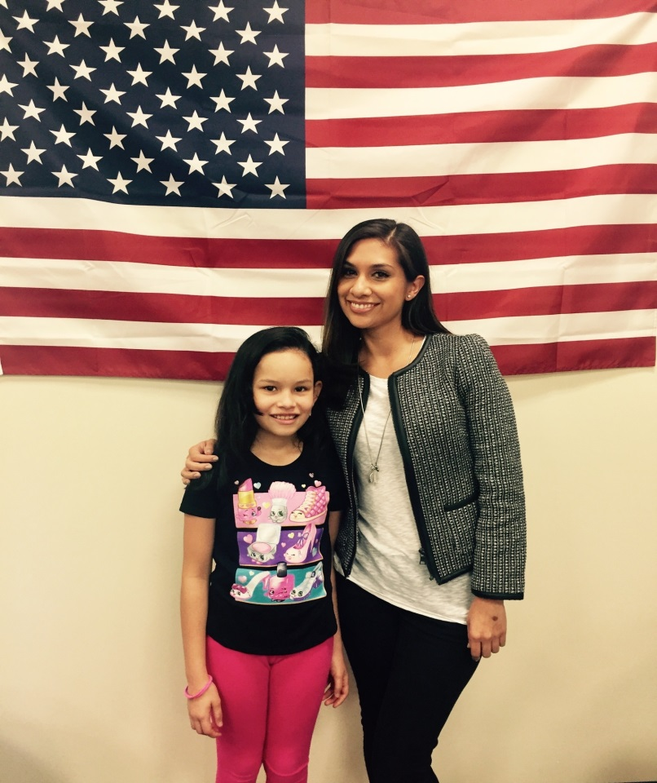
HOW DO I WORK WITH A CHILD CLIENT?

Slide 32
BUILD A RELATIONSHIP OF TRUST
Explain that your role as the child’s attorney is to express and advocate for client’s interests and wishes
Meet privately with the child and establish direct communication
Explain the process to the child’s reasonable understanding
Help your client understand privilege and confidentiality
Build trust – Help your client understand that the two of you are part of a team
Understand that your client
  may be reliving trauma while disclosing facts
  may not be an accurate reporter of dates, duration, frequency, proper names, etc. (Try asking questions in multiple ways; create timelines, diagrams, etc. as aids)
  may define normalcy by his own experience

Slide 33
PREPARE CHILD FOR COURT AND USCIS
Help child understand roles: judge, ICE attorney, child, counsel, interpreter
Elicit facts & descriptive details, rather than conclusions
It’s okay for the child to say, “I don’t know,” “I don’t remember,” “I don’t understand”
Prepare child for Direct and Cross examination: elicit information in a variety of ways
Practice at least one full mock hearing with child before an individual hearing and/or asylum interview

Slide 34



BENEFITS OF PRO BONO REPRESENTATION
Rewarding work with tangible impact!
Enhance legal skills of persuasion, witness prep, direct exam, and more!
Mentorship, guidance and resources provided by KIND at each step!

Slide 35
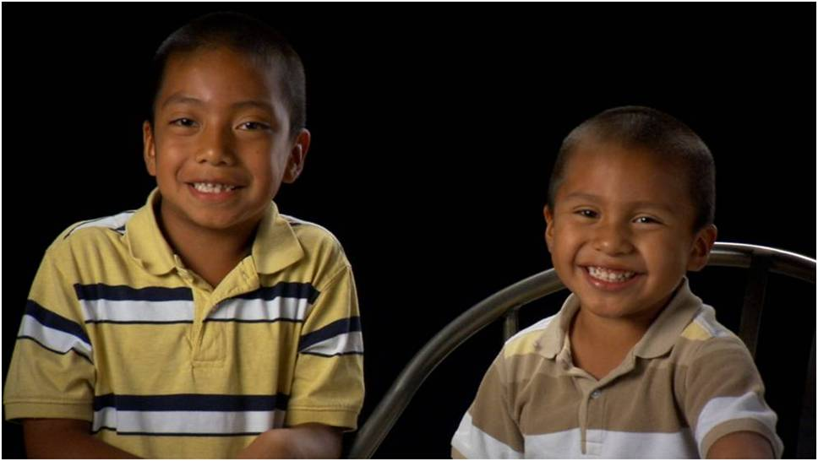
BENEFITS OF PRO BONO REPRESENTATION
70% of UAC lack representation
Only 15% of unrepresented children avoid being returned
Represented children are 5 times as likely to obtain relief from removal.
See: http://trac.syr.edu

Slide 36
QUESTIONS & CONTACT INFO
Salma Hasan
shasan@supportkind.org
(832) 241-7029
Claire Doutre
cdoutre@supportkind.org
832-779-4030
www.supportkind.org

